Slide 1
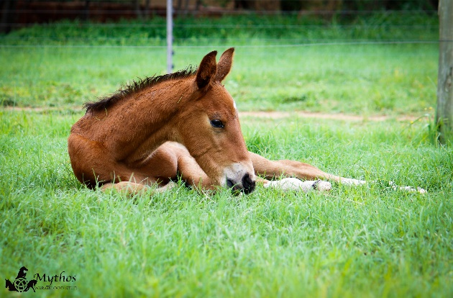

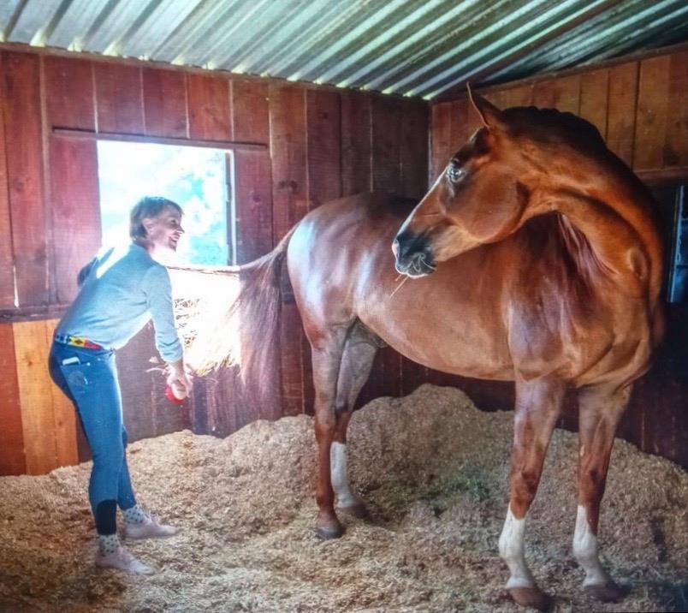
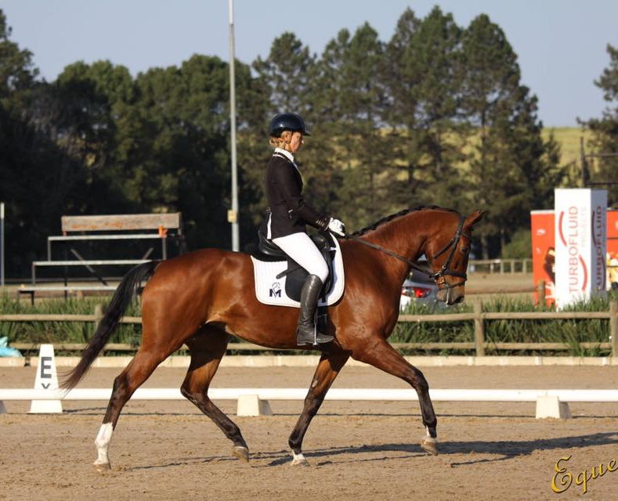
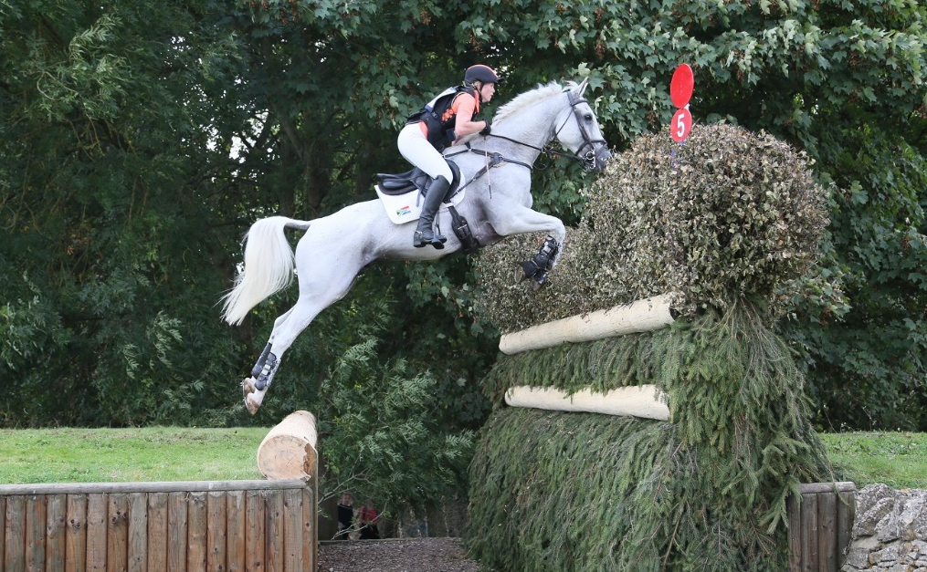

SAWHS quick tips
for new members, breeders or foal owners
Welcome to breeding or owning warmbloods. This is meant to be a quick overview for you. There is a lot more information on our website. Follow us on Face Book and Instagram.

Slide 2
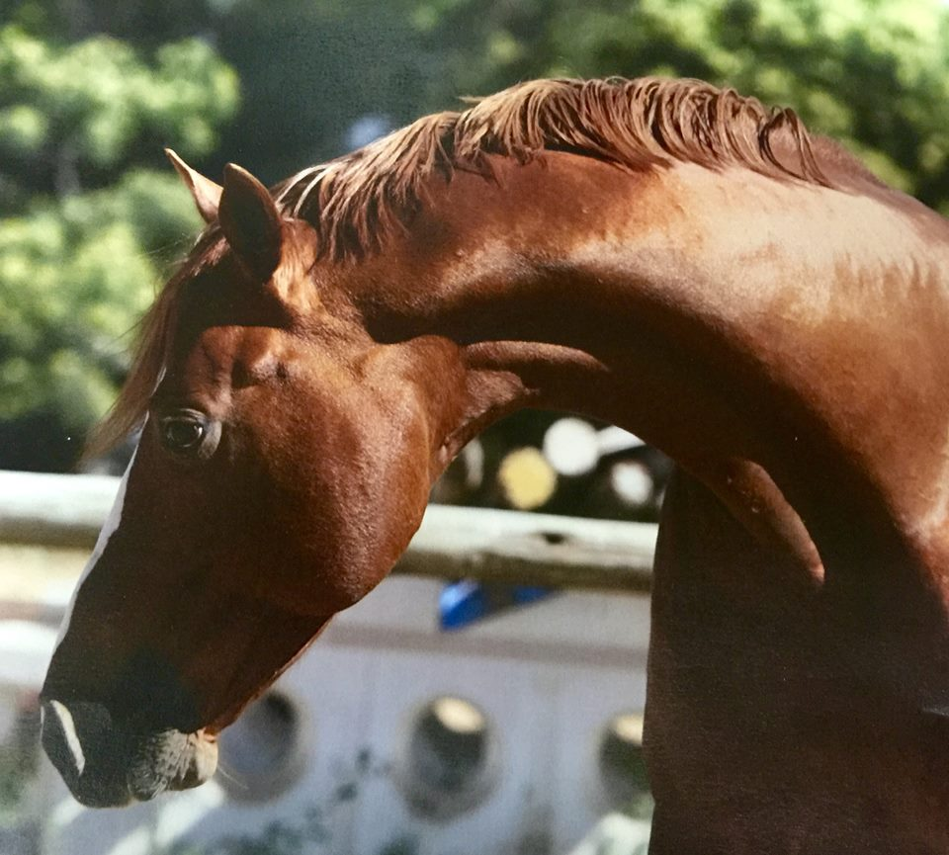

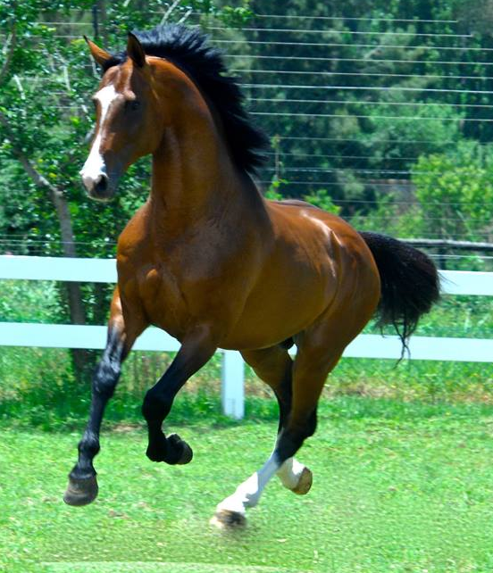
The stallion
The stallion should at least have been presented for First Acceptance if he is unbacked.
Full License means he has been seen under saddle as well as conformation. This is the crucial recognition.
If he has Inspected status, he is not licensed. It means the inspection panel feel he is a good sport horse but not necessarily a breeding stallion prospect. His progeny will still be accepted.
However - a stallion can always prove himself by competing at a top level, or through the excellence of his progeny.
So the outcome of the License status is not set in stone.
See more detail on stallion statuses, over stamping of overseas licensed stallions, Sports predicates and Inspections in the Members Guide
A lot of emphasis is put on the stallion when people do their research & selection. But he cannot do it alone. If the mare has conformational issues, lacks height and no performance record to compliment the stallion, this is a far stretch.
STALLION SAYING:
When you look at a horse’s pedigree, it tells you what he ought to be.
When you look at him competing in the ring, it tells you what he seems to be.
It is only when you see the progeny that you know what he is as a breeding stallion!

Slide 3
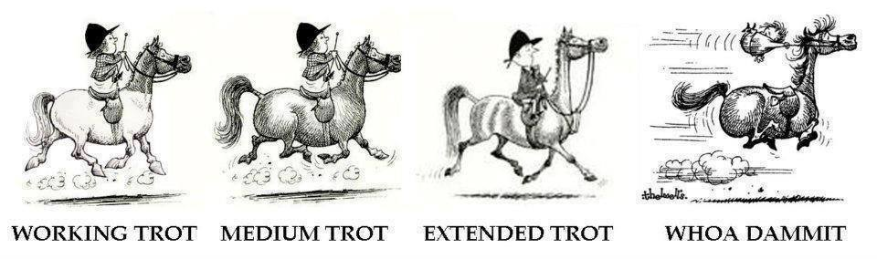
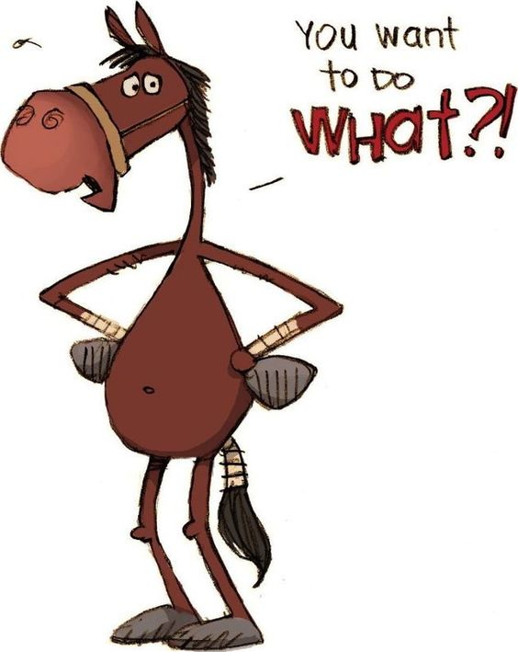
Choose your mare carefully!
The mare must be top class or the best you can afford, either in conformation or proven in competition or via her progeny.
She should be inspected to assist you with knowing her weaknesses & strengths.
Pedigree should be checked with the SAWHS as many people out there are not always honest or as knowledgeable as they may lead you to believe.
Has she had DNA done to prove the pedigree if the grand dams and/ or sires are not inspected or registered?
Height: while we accept 15.1hh for a mare, you are wise to start with a mare of 16.hh upwards. It seems that horse’s easily loose height in our arid and semi arid conditions. Until you know which way your mare throws, check back in the pedigree what sizes her great grand sires & dam’s stood.
Look for good temperament, rideability and an uphill build
Limbs are important and we emphasize good legs in our selection criteria.
To put an unproven mare in foal because you have no other use for her, or use a cheap & cheerful buy, leaves you at a below average starting point. The cost to catch up with the market place, will take years

Slide 4
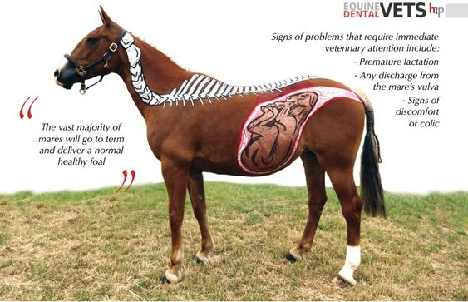
Covering the mare
Today most people impregnate the mare by using fresh semen or frozen semen via Artificial Insemination (A.I)
Some breeders are still available to do hand served live covers. This can be a great help for older mares or mares with certain issues like cysts or fluid
Presently the Director of Animal Health, of the
Department of Agriculture, Forestry and Fisheries
orders that stallions doing A.I must have an annual CEM test.
See Government notices as this disease is monitored
African Horse Sickness (AHS) and the pregnant mare.
Normally the mare will be vaccinated in her last trimester but not in the last month before birth. This vaccination carries over a certain amount of immunity to the young foal especially for the first 4 months.
Discuss the latest protocols with your vet.

Slide 5
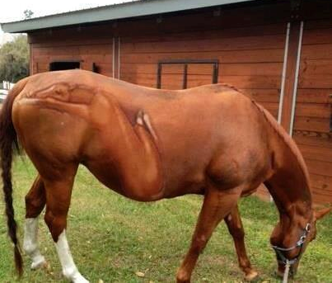
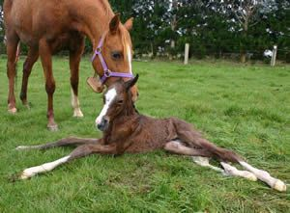
Your foal is born, you are over the moon
The foal delivery should be monitored by experienced stable owners, breeders or a vet. There are so many issues to know about.
When things go wrong you have to be quick. So we leave that area to their expertise
IgG levels via a blood test - this is vital if there are any concerns that the foal may not have received adequate colostrum. The SNAP Foal IgG Test can be done on site. It is best to order this kit in advance from your vet as often they don’t keep stock.
The vet may choose to give the foal a tetanus antitoxin and antibiotic injection.
A ‘foal enema’ may be given to ensure meconium has been passed.
Attend to the umbilical cord with a good antiseptic like Iodine
Some post foaling pointers:
Within 1 hour: foal should stand
Within 2 hours: foal should suckle, be sure the foal has good sucking reflex & gets sufficient colostrum
Within 3 hours: placenta should be passed. Check complete placenta is out and nothing left in the mare

Slide 6
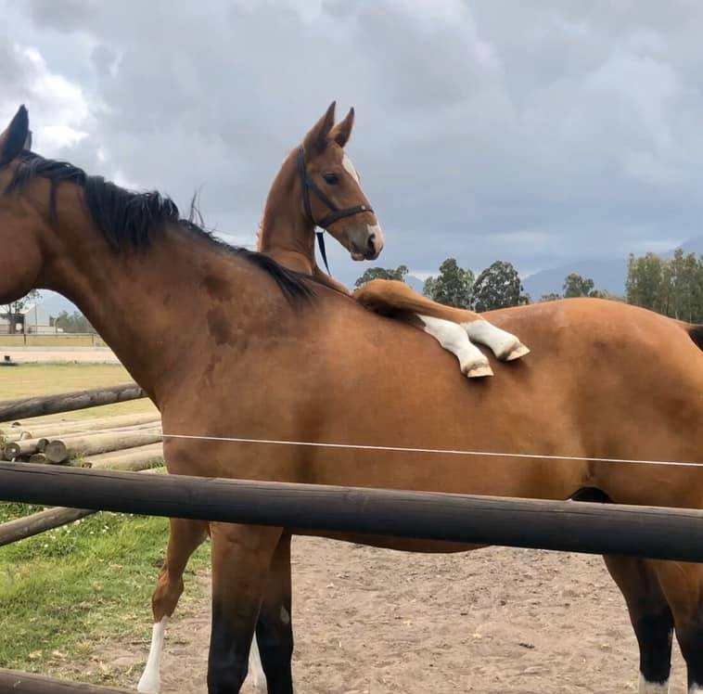
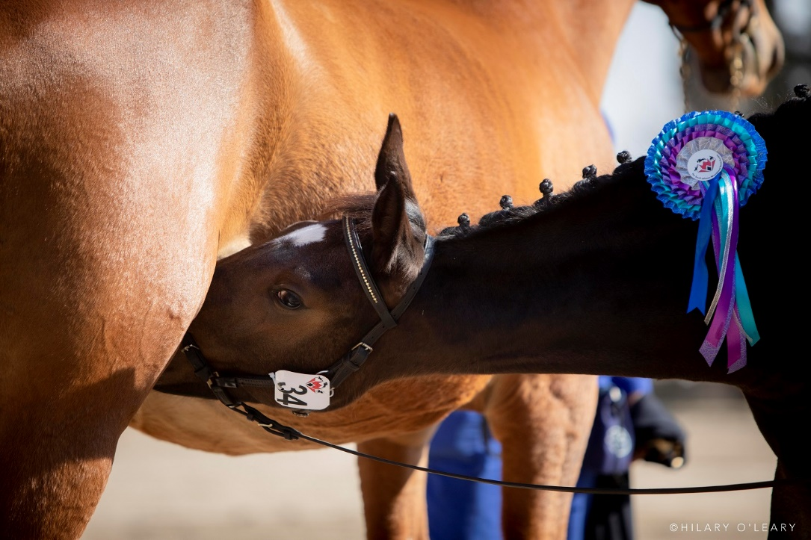
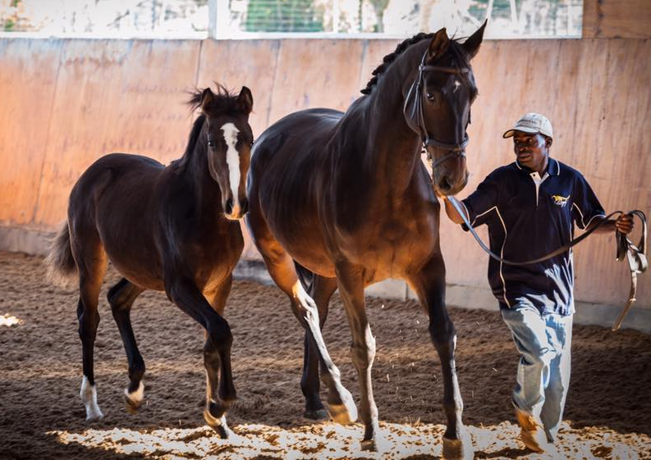
Your foal While you wait & watch your future champion grow, what can you do together ?
After halter training and general handling you can teach the foal to box while still with it’s mother. This means you can take them to the vet if the mare is to be inseminated or foal is ill; or if entering a breed show like the Horse of the Year or our Free Movement events. In this way your foal takes in a huge amount of information while with its mother for re-assurance. The mother’s demeanour also teaches the foal.
The foal needs to have DNA done & be Birth Notified with the SAWHS in its 1st year. There is a triplicate form which you get from the office. You will also need a Cover Certificate from the vet or stallion owner.
African Horse Sickness & the foal If the foal is from an unvaccinated mother, you can vaccinate at three months of age. Before that it won’t develop an immunity. These foals must be given two vaccines three weeks apart and then re-vaccinated six months later with two doses. If the mother is vaccinated, foals should not be vaccinated before four months of age – foal immunity in these cases has been shown to last up to six months. It is highly recommended to vaccinate a foal twice in the first year. Please check with your vet for the latest information
Most studs wean between 6 to 8 months of age.
As this is a most stressful event for the foal, it can be more susceptible to infection, and show a decreased weight gain for several weeks.

Slide 7
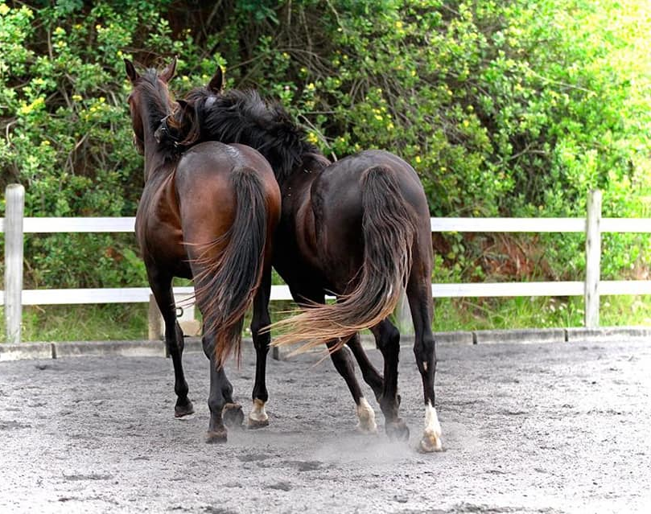
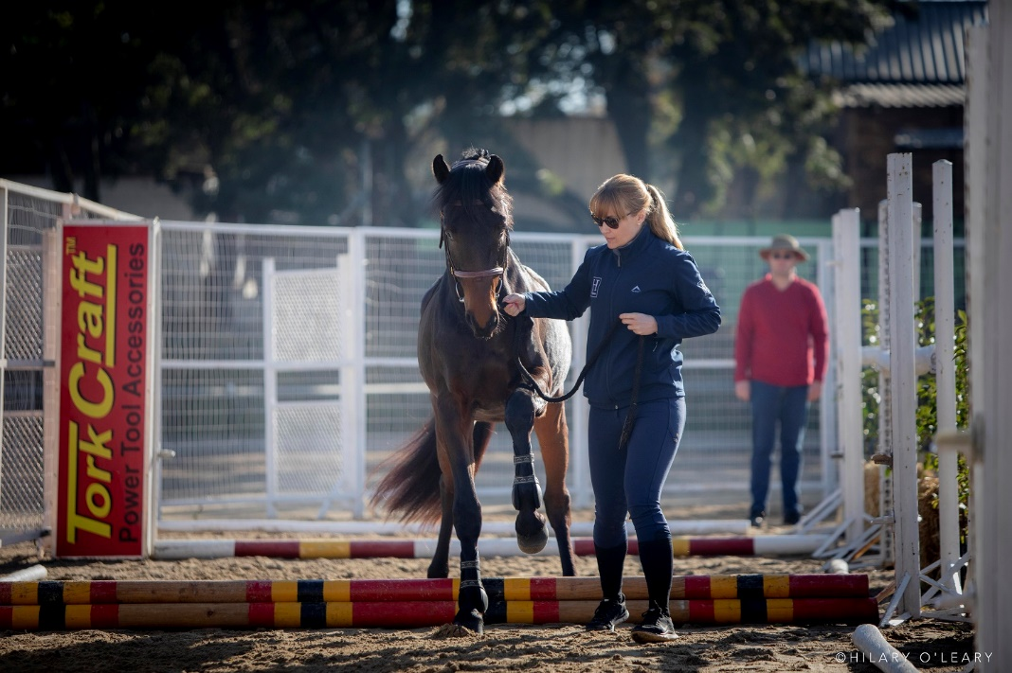
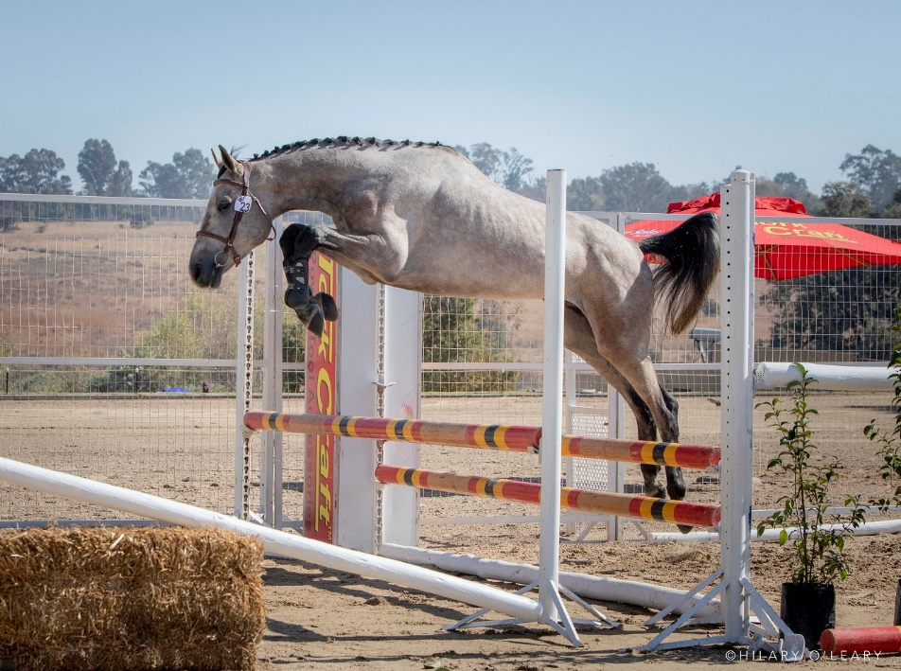
Weanling to three years old – all out of shape
The saying goes: To see what your future horse may look like, look at your youngster at 3 days old, 3 weeks and then again at 3 years. From the time of weaning to around 3 years old, they can grow in a very uneven way, croup high one month, scrawny neck the next month. Don’t be alarmed, they are in the teenager phase.
Once your young horse is two years old you can also include the SAWHS Free Jumping Competition to your program. This gives you the opportunity to add to the
training of the young horse and for you to see his character. Going to the event again adds to it’s exposure of new venues and new experiences. The horse develops confidence and you grow your relationship with the youngster.
In his third year basic ground work can be done with lunging introduced and later even a bit of long line work.
Don’t forget there are still the breed shows and the Loose Movement show.

Slide 8
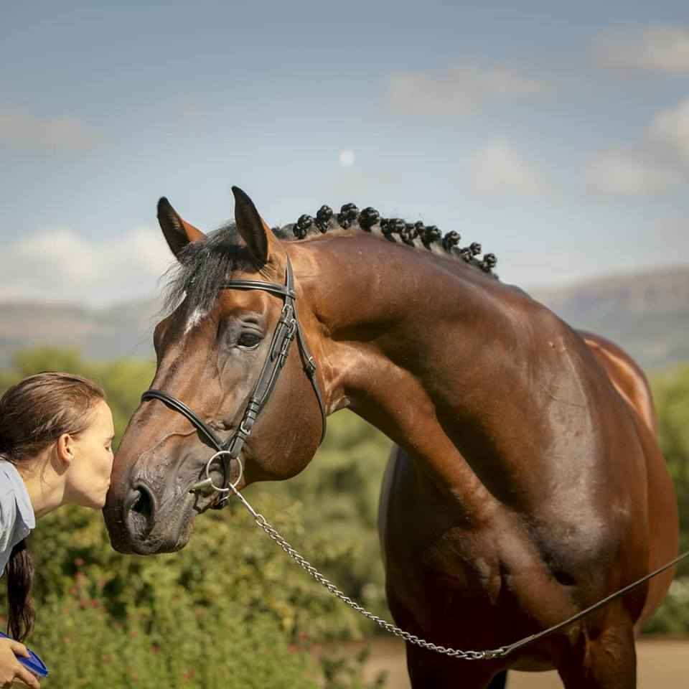

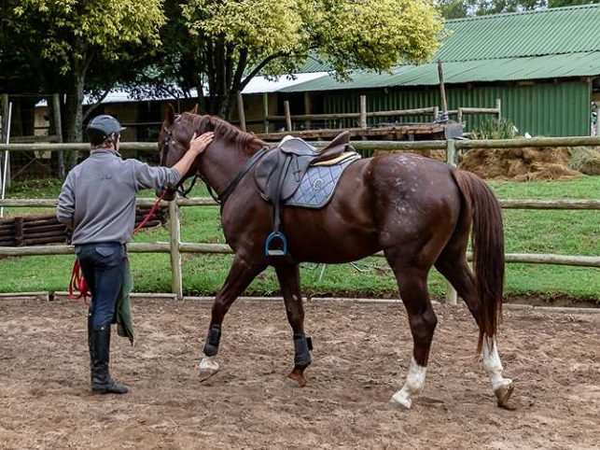
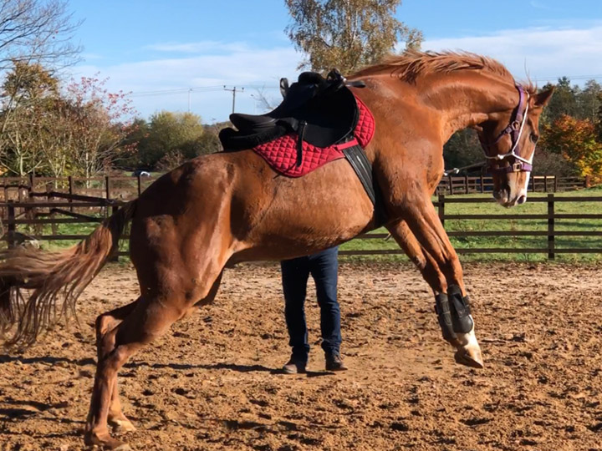

Finally the day arrives
Backing the best horse there ever was.
Every one has their own methods of approaching the backing process. Warmbloods are slower to mature than thoroughbreds especially if they are ranched out. Once being backed, horses are normally stabled and you may be surprised to find how much your horse still grows in the coming four years.
Many people back at three and get the horse to understand a very basic set of aids. They then leave the horse for 6 months to a year, depending on its development and pick up again around 4 to 4.5 years old.
Other people prefer to wait until 4 to 4.5 years and continue on with the training directly. Now you a ready to start
Once your horse is under saddle the Young Horse Performance Series is a nice way to introduce him to Show jumping competitions

